Slide 1
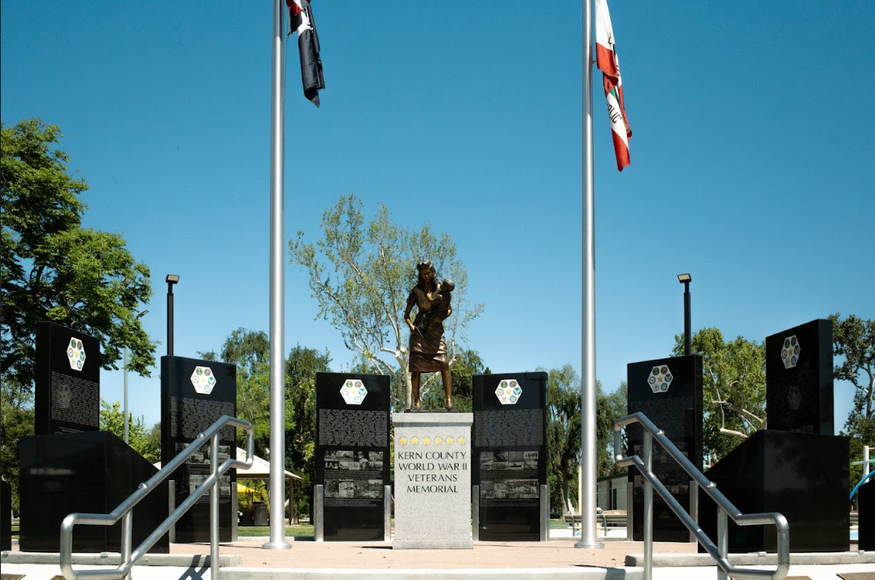
KERN COUNTY WWII VETERANS MEMORIAL
JASTRO PARK
2900 Truxtun Ave., 93301

Slide 2
WHO WE ARE AND HOW WE GOT STARTED
Board of Directors President - Ed Gaede Jr. Vice President - Wendy Ward Secretary - Amy Watkins Treasurer - Karen Lopeteguy WWII Veteran - Walter Grainger Member at Large - Kathleen Grainger-Schaffer
Member at Large-Penny Martinex Member at Large - Jacquie Sullivan

Slide 3
WHY WE ARE DOING THIS
**First and only WWII Veteran Memorial in Kern County**
Mission Statement
To create a permanent tribute honoring all Kern County WWII Veterans and those who supported them.
Vision Statement
To serve our community with a beautiful memorial honoring Kern County WWII Veterans that will be a place of reverence, remembrance, and education for all who visit.

Slide 4
MEMORIAL DESCRIPTION
“The Kern County WWII Veterans Memorial has…
Six (6) large black granite pieces placed in a semicircle.
Each granite piece represents the six (6) branches of the American Armed Forces during WWII.
Engraved on the front of each black granite piece are the names of the 684 Kern County WWII Veterans who lost their lives in action during the war.
Engraved on the opposite side of these black granite pieces are the names of sponsored Kern County WWII Veterans who served and returned home.
Four (4) smaller black granite pieces at the forefront of the memorial, display the names of the organizations that supported the war effort.
Memorial Centerpiece​
The centerpiece has a 5-foot base with the county and city seals placed on it along with six (6) gold stars representing each of the branches of Armed Forces as well as the memorial name.
On top of the base is a 6' full sized sculpture by Benjamin Victor of a mother holding her child after having read a telegram that says, “The War Department regrets to inform you…”
The perimeter of the memorial has six (6) solid granite benches.”
An etched educational timeline, depicting events of WWII.

Slide 5
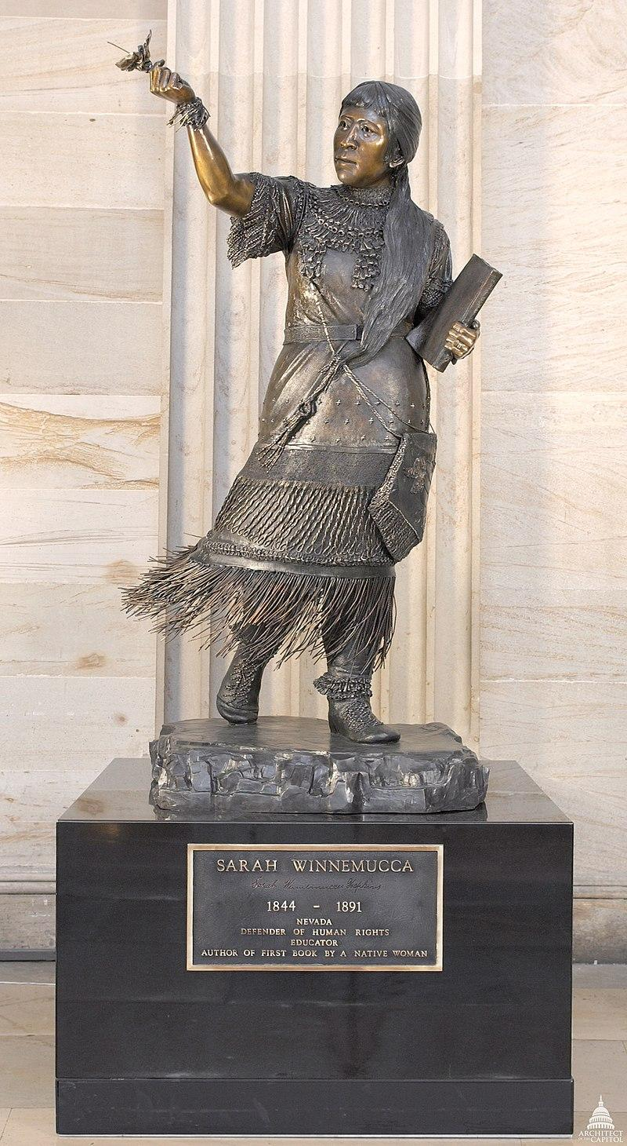
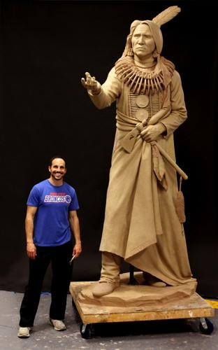
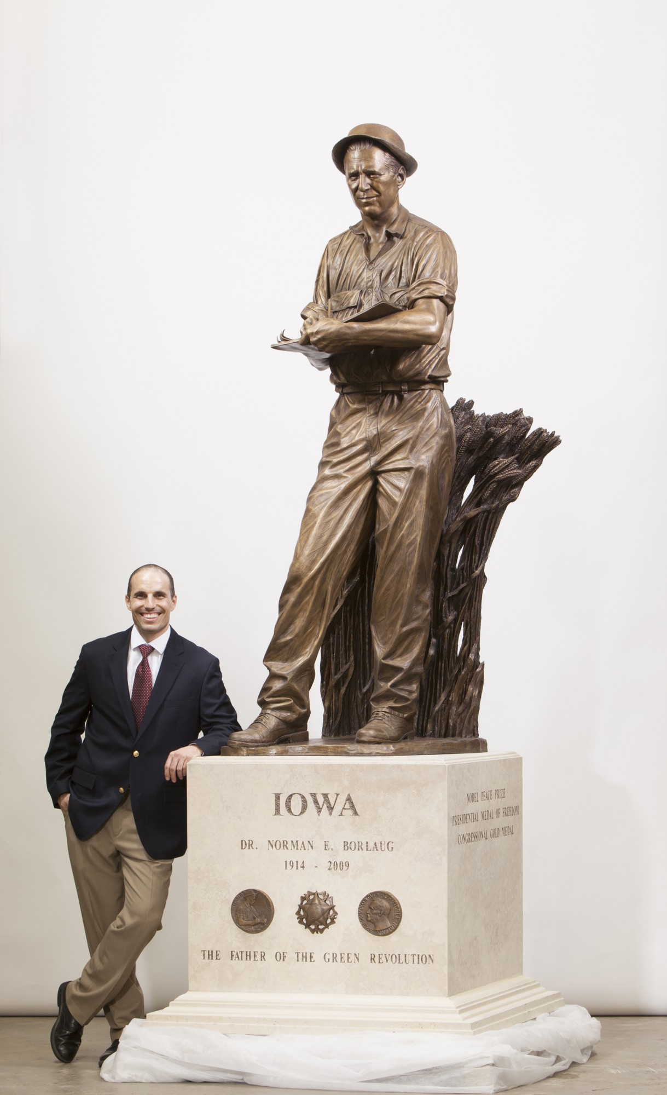
OUR ARTIST, BENJAMIN VICTOR
Bakersfield Native & graduate of Foothill High School
World Renowned Artist & Sculptor
Boise State Professor
At age 26, he became the youngest artist ever to have a sculpture in our Nation’s foremost collection, the National Statuary Hall in the United States Capitol.
In 2019, he became the only living artist to have 3 works in Statuary Hall
Iowa, Nebraska & Nevada
He is now working on a piece to represent Arkansas…his 4th for the National Statuary Hall
Benjamin has sculptures & monuments across the county depicting and honoring historical figures, Native Americans, first responders, classical figures and more.
Art critics and organizations, including the National Sculpture Society in New York City, continue to recognize the aesthetic and conceptual integrity of Benjamin’s artwork.

Slide 6
OTHER MEMORIAL DETAILS
The memorial will include an educational piece-historical timeline
Local contributions to the war effort
Edwards Air Force Base-Muroc Army Air base, Minter Field, Meadows Field, Tank Factory supply warehouse, Top Secret Boeing warehouse for airplane parts, Internment camp relocation, POW camp in Shafter, Gun/munitions factory in Bakersfield, Ship parts factory, Gardner Field in Taft, China Lake NWC
Associations that supported the war effort
Rosie the Riveters, Wendy the Welders, Women’s Army Corp (WACS), Women Air Service Pilots (WASPS), Women Accepted for Volunteer Emergency Service (WAVES), Army Nurse Corps, Navy Nurse Corps, United Service Organizations (USO), Tuskegee Airmen, Red Cross and American Indian Code Talkers.
DEDICATION
December 10, 2022

Slide 7
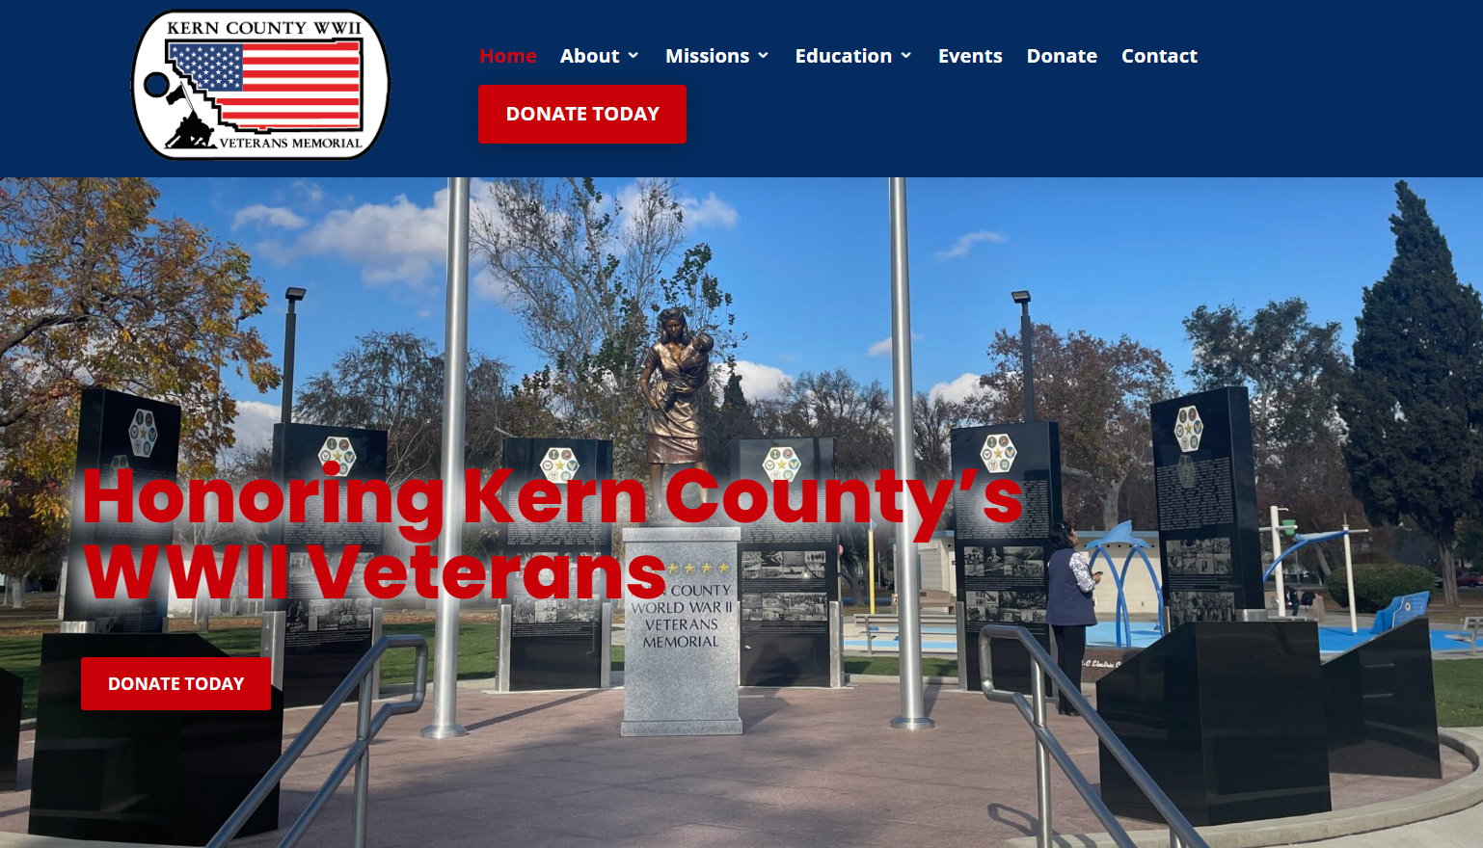
WEBSITE & SOCIAL MEDIA
Website https://www.kerncountywwiimemorial.com/
Facebook @KernCountyWWIIVeteransMemorial
Instagram @kerncountywwiivetmemorial

Slide 8
QUESTIONS?
If you have any questions please contact…
President, Ed Gaede Cell Phone: (661)343-7658 Email: KernCountyWWIIMemorial@gmail.com Kern County WWII Veterans Memorial, 6077 Coffee Road #4-192, Bakersfield, CA 93308

